Slide 1

AFIO Meetings, Site Visit &
Solution Refinement
AFIO SCANAI
Project Progress Review
01

Slide 2
Project Progress & AFIO Engagement
1
Initial Commandant meeting
AFIO hospital visit
2
Workflow observations
3
Refined project direction
4
Next development roadmap
5

Slide 3
Commandant Meeting: Requirements
AFIO's Four Primary Agendas
Memory Bank
Teleophthalmology
Additional requests:
continuous ophthalmologist feedback
local clinical datasets
validation using AFIO images
Image Integration
AI-based Report Generation

Slide 4
AFIO Visit: Current Hospital Workflow
Patient Vitals & AR check
→
Referred to Clinician
→
→
Technician performs scan
Scan Requested
(on suspicion)
→
Referred to specialist
(if required)
Return to consultant
Print Report
Software Report
→
→
→

Slide 5
AFIO Visit: Further Observations
Equipment Observed
What We Observed
Manufacturer software already performs image analysis
Reports printed immediately after scan
Images available digitally inside software
No centralized patient database
Limited electronic storage and report sharing
Consultants review only selected patients
Topcon OCT Systems OCT
Heidelberg OCT OCT
Optovue OCT Retinal
Specular Microscope Corneal
Galilie Corneal Topography Corneal
Hamphrey Field Analyzer Glaucoma
Optos Ultra-widefield Fundus Camera

Slide 6
Problems Identified at AFIO
No Central Memory Bank
Fragmented Data
1
2
AI Reporting Needed
Workflow Issues
3
4
CONSULTANT FEEDBACK (Col. Aamir)
AI prediction was accurate, but the report format didn't fit hospital workflows, highlighting the need to prioritize report usability alongside model accuracy.

Slide 7
Memory Bank
Memory Bank / Database
Shared Folder Pipeline
AFIO currently has zero digital storage. Every scan report exists only on paper and is lost after the visit. They need a permanent searchable archive of all patient scans across all 10 machines.
Technician exports scan from any machine software → saves to one shared folder on the central PC → AFIO ScanAI picks it up automatically. One extra click per scan, nothing else changes.
Metadata Extraction
Multi-Machine, One PC
System reads the exported file (JPEG, PDF, or DICOM), extracts patient name, ID, scan type, and clinical values, then fills the database automatically without manual data entry.
10 different imaging machines each with their own software, all connected to one central PC. AFIO ScanAI runs on that PC, watches the shared folder, and handles output from every machine.

Slide 8
IMPLEMENTATION OPTION
Solution 1: AI-Based Image Analysis (Continue Our Original Project)
Continue with our current AI models: raw ophthalmic images (Fundus, OCT, Corneal, etc.) are analyzed directly to generate disease predictions, and the doctor verifies the AI output before finalizing the diagnosis.
Workflow
Imaging Device
→
Raw Image (JPG/DICOM)
→
AFIO ScanAI
→
Disease Prediction + Grad-CAM
→
AI Report
→
Doctor Validation
→
Dashboard + Database
Advantages
Challenges
Requirements
Builds on work already completed
Independent of manufacturer software
Works across different hospitals
Explainable AI via Grad-CAM
Extends easily to smartphone cameras & teleophthalmology
Performance depends on image quality
May require retraining on AFIO images
Results may differ from manufacturer reports
De-identified JPG/DICOM images from AFIO
Local validation, with fine-tuning if needed

Slide 9
IMPLEMENTATION OPTION
Solution 2: AI-Assisted Clinical Reporting (Use Machine Results)
Trust the diagnostic machines to perform the medical analysis. AI interprets the machine-generated findings into structured, clinician-friendly reports — acting as a clinical assistant, not the primary diagnostician.
Workflow
Diagnostic Machine
→
Machine Report / DICOM
→
AFIO ScanAI
→
AI Clinical Interpretation
→
Summary + Risk Stratification
→
Unified Report
→
Dashboard + Database
Advantages
Challenges
Higher clinical reliability
Aligns closely with current AFIO workflow
Faster deployment
Less dependence on AI accuracy
Easier acceptance by clinicians
Requires access to DICOM or machine-generated data
AI depends on manufacturer outputs
Less emphasis on independent disease detection

Slide 10
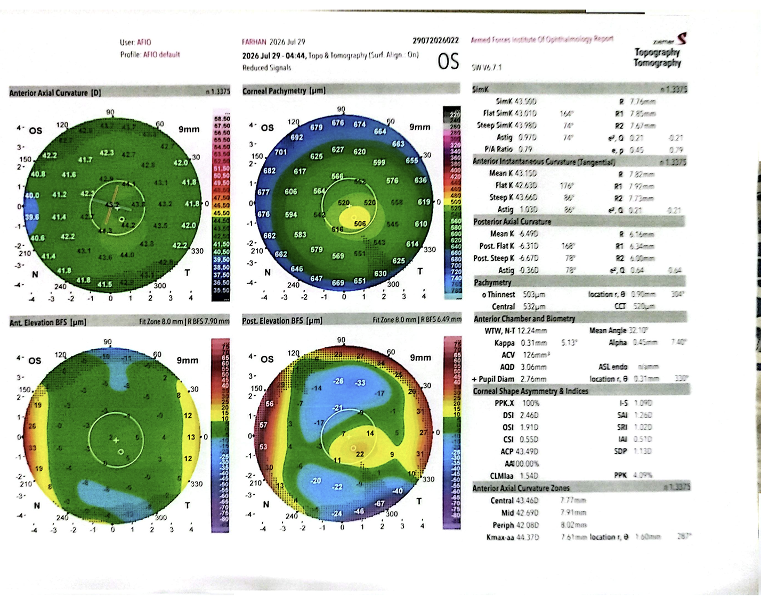

Slide 11
IMPLEMENTATION OPTION
Solution 3: Hybrid Intelligent Platform
Combine both approaches: the diagnostic machine performs its analysis while our AI independently analyzes the raw image, and the system merges both into one unified clinician report.
Workflow
Diagnostic Device
→
Machine Analysis + Raw Image
→
AFIO ScanAI
→
AI Prediction + Machine Findings
→
Combined Clinical Report
→
Doctor Review
→
Dashboard + Database
Advantages
Challenges
Combines machine analysis & AI strengths
Independent verification of machine findings
Better explainability and richer reports
Can start manual and evolve into full DICOM integration
Most scalable, future-proof solution
More complex implementation
Requires synchronization between images and machine reports
Needs local validation before deployment
Each of 10 machines has its own export format

Slide 12
SOLUTION COMPARISON
Comparing the Three Approaches
Feature | Solution 1 AI Image Analysis | Solution 2 AI Clinical Reporting | Solution 3 Hybrid Platform
AI analyzes raw images | ✅ | ❌ | ✅
Uses machine-generated reports | ❌ | ✅ | ✅
Independent disease detection | ✅ | ❌ | ✅
AI explains machine findings | ❌ | ✅ | ✅
Compatible with existing workflow | Moderate | High | High
Needs retraining | Possibly | No | Minimal
Future DICOM integration | Yes | Yes | Yes
Dashboard, Memory Bank & Database | ✅ | ✅ | ✅
Recommended | Good | Good | Good

Slide 13
STAKEHOLDER VALUE
Why This Solution Fits AFIO
1
Technicians
2
Clinicians
3
Specialists
4
AFIO (Institution)
No repeated documentation
Faster report generation
AI-assisted interpretation
Standardized reporting
Faster decision support
Complete patient history
Previous scans available instantly
Unified report across modalities
Digital Memory Bank
Centralized database
Image integration
Future teleophthalmology
Scalable AI platform
07

Slide 14
AFIO SCANAI
Common Components for All Solutions
Regardless of the implementation strategy, every proposed solution includes the following core components.
01
Unified Clinical Dashboard
02
Centralized Database Management
Technician Dashboard
Consultant Dashboard
Patient Portal
Admin Dashboard
Role-based Access Control (RBAC)
Patient Database
Image Repository
Reports Archive
Audit Logs
User Management
03
AI-Assisted Reporting
04
Future Teleophthalmology Support
AI Disease Prediction
Plain-language Clinical Summary
Confidence Score
Grad-CAM / Explainable AI
Doctor Verification before Finalization
Remote Screening
Smartphone Fundus Camera Support
Rural Healthcare Integration
Remote Specialist Consultation
09

